Slide 1
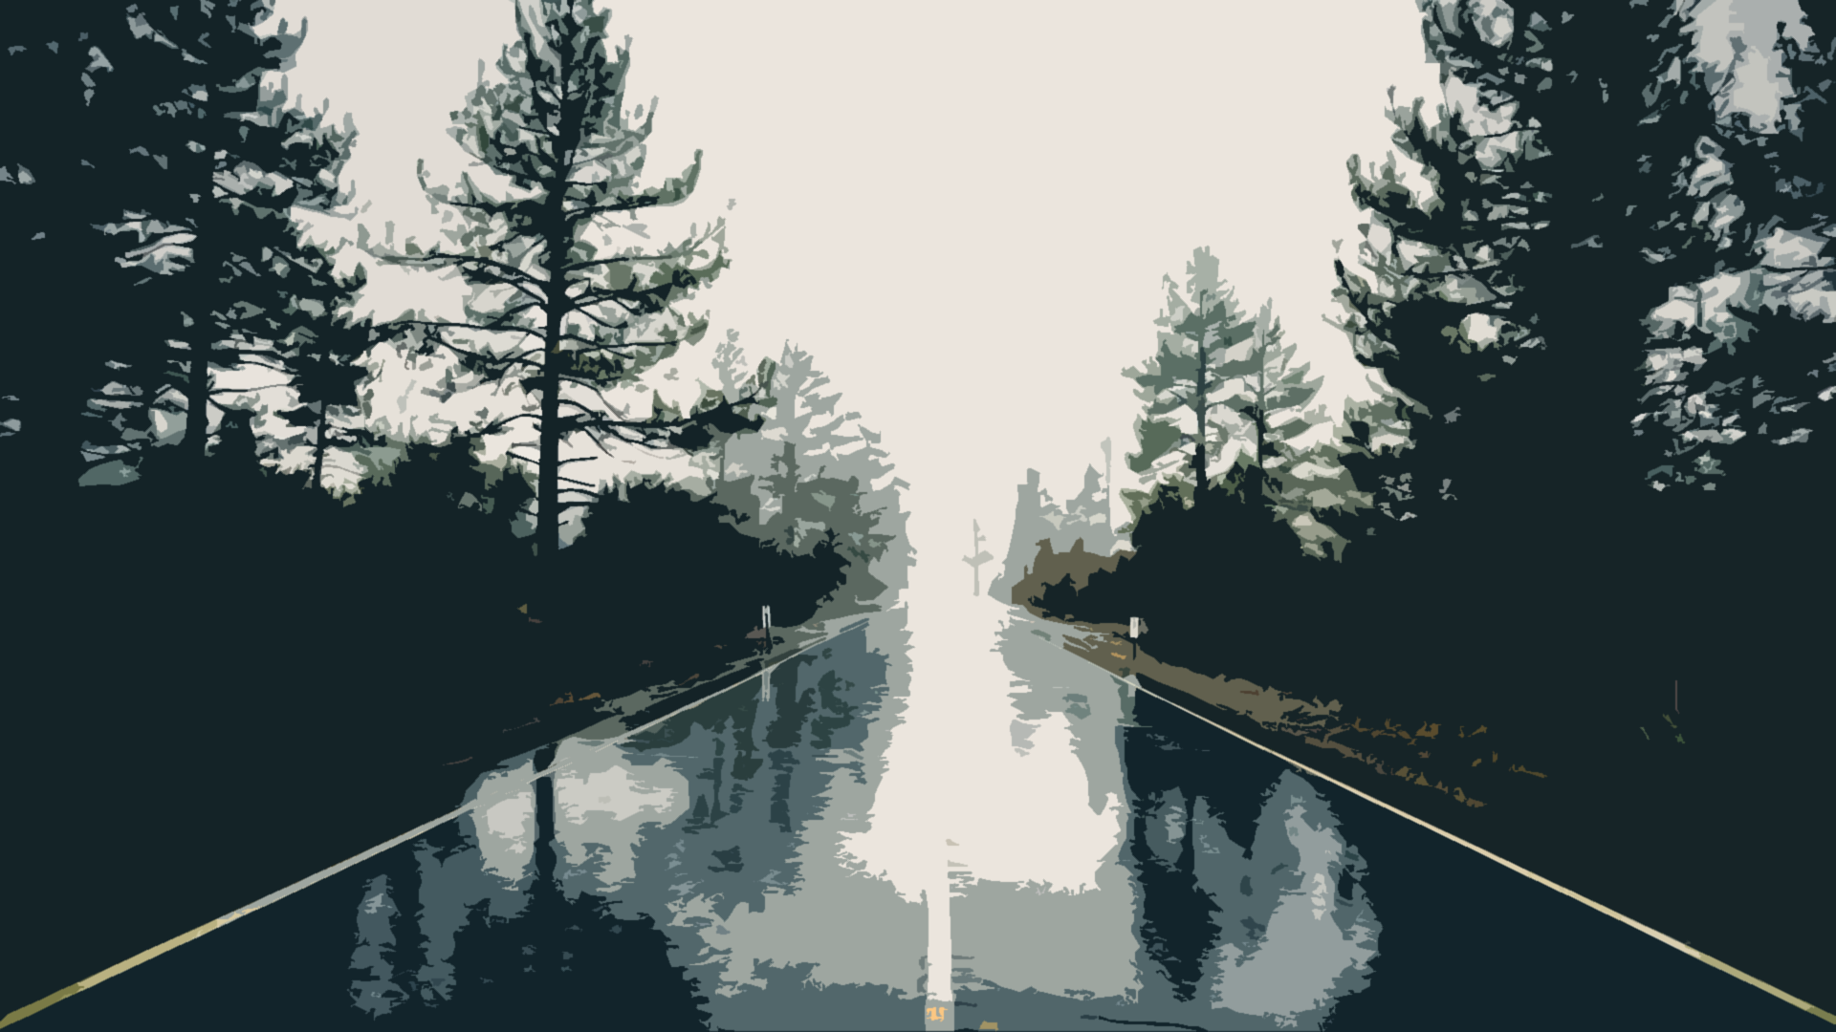
My Roadmap
- Max

Slide 2

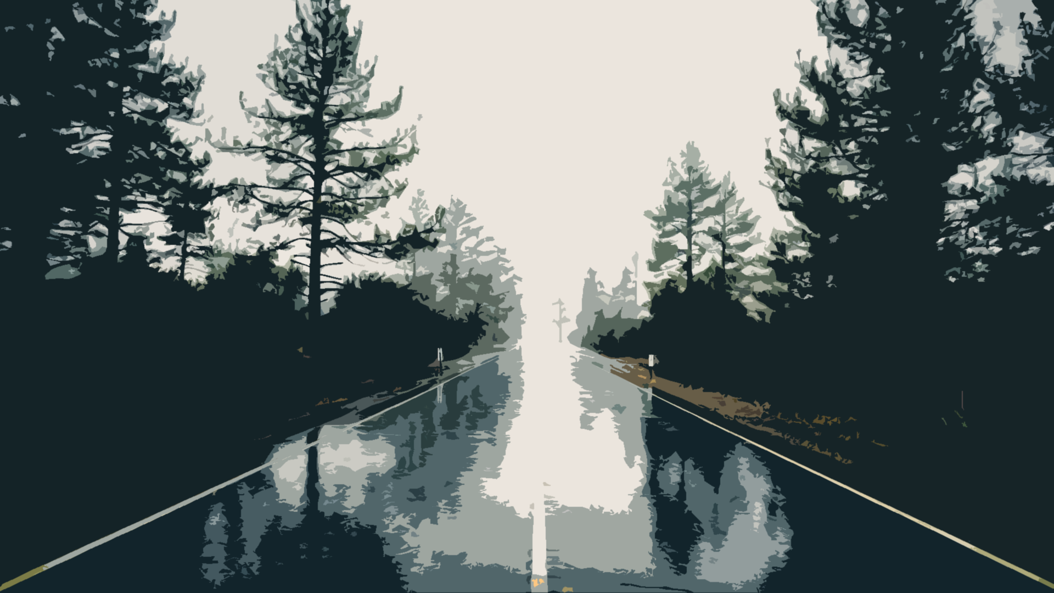


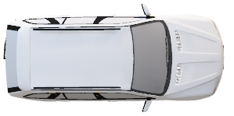
03/06- Asthma Attack
The only thing I remember as a small child was my asthma attack when I was 3 years old. I was sleeping peacefully in my bed one night and all of a sudden, I woke up not being able to breathe. I rushed to my parent’s room and they had to call the ambulance. Thankfully, I regained my breathing well before they arrived, but it still left me with a scar. I now give a very wide berth to cats and rabbits and always carry an inhaler at all times.

Slide 3

07/08- Deal
One day when my mother & I were shopping, we drove past a pregnant mother who was smoking with another baby in a stroller. I pointed it out to my mother, and the she made a deal with me. If I don’t smoke, drink alcohol, or do drugs until graduating high school, then I will get $1000. I recently remembered this and will keep up my part of the deal.

Slide 4


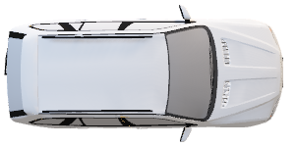
09/08- French Immersion
When I was 5, I started kindergarten. My parents placed me in a French immersion school even though there was a regular school down my street. I still don’t regret their choice to this day because it helped me in France and also when we went to Quebec to ski, hike & travel.

Slide 5

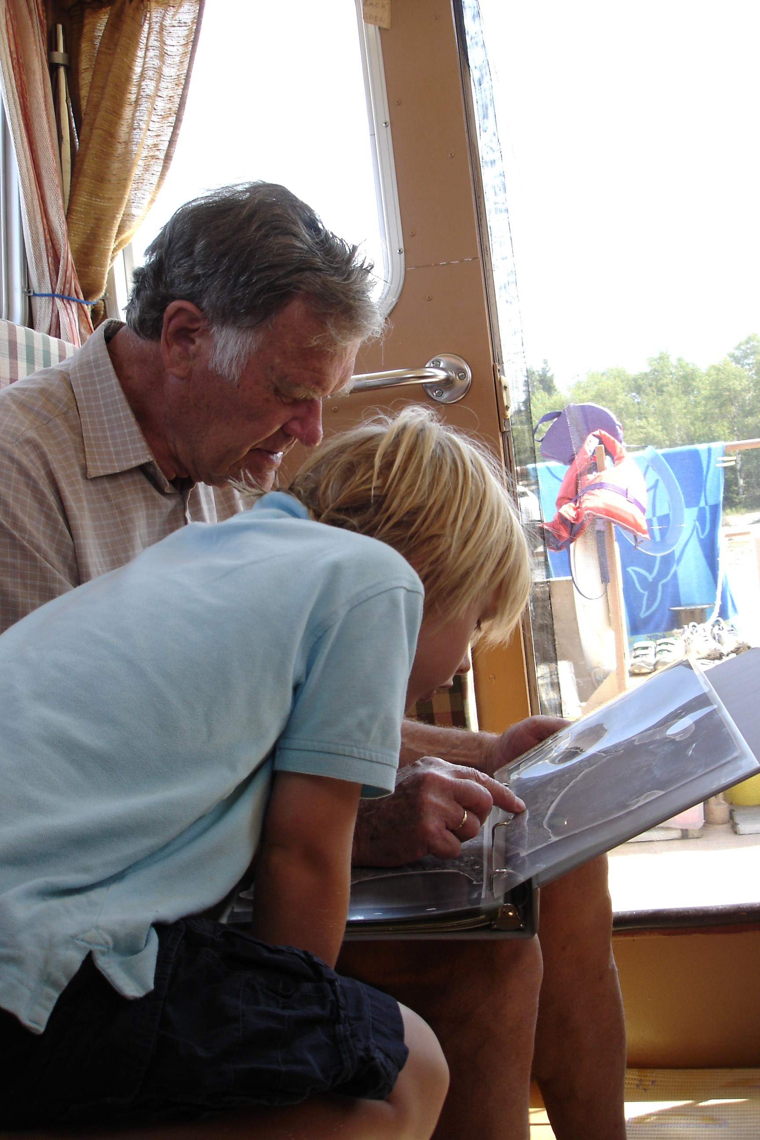
02/13- opa
One day after school I spontaneously heard that we were flying to Winnipeg to visit my Oma & Opa. I realised soon after we landed that the visit was not going to be a pleasant one. My Opa was diagnosed with colon cancer a few years before and was recently sent to the hospital. A week after we arrived he passed away. This was the first time a close relative passed and I don’t know if I even fully comprehended that I wasn’t going to see him again. It was the first time I felt true sadness.

Slide 6
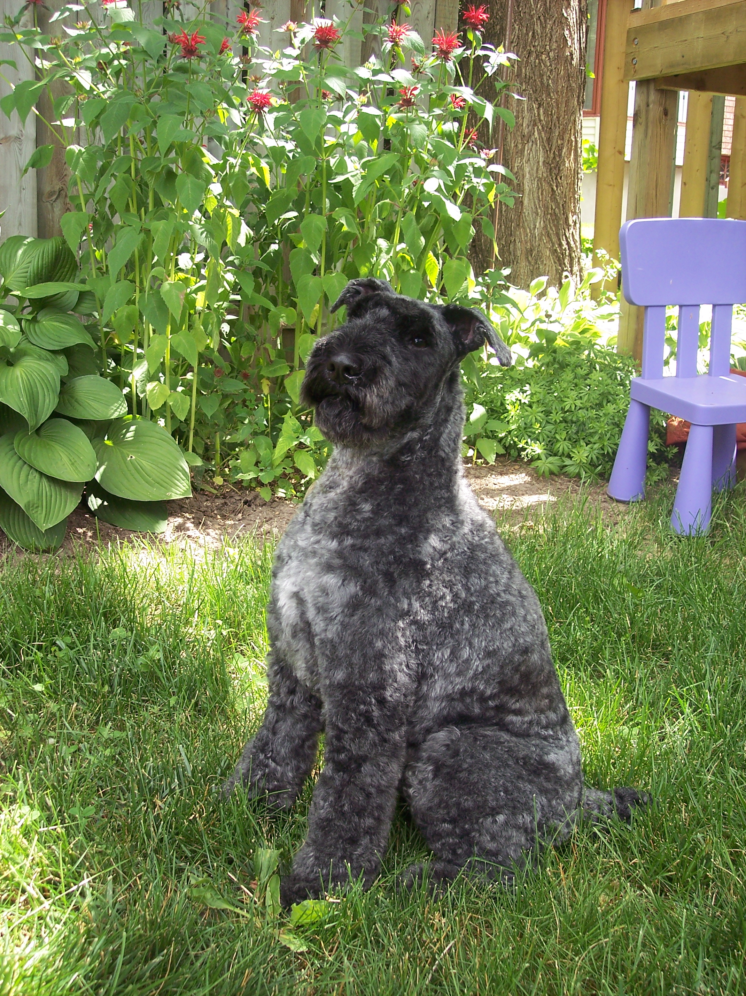
04/14- Irish
One day I was playing with my Kerri Blue Terrier Irish, and I came into the living room all excited, and Irish thought that I was a threat and bit my arm. It wasn’t deep and it didn’t leave scars, yet my parents thought that we had to let go of him. I pleaded with them forever but they wouldn’t budge. He went to live on a farm with a happy-go-lucky gentlemen. Since I was closer to Irish, it was more devastating losing him compared to Opa. Irish made me love having a dog in my life as well as loving animals in general.

Slide 7

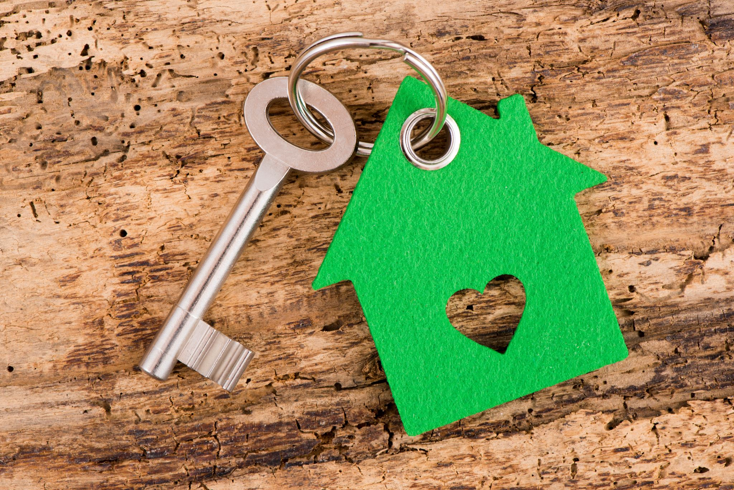
09/14- Moving
Sometime after the school year, my dad got a job transfer offering to his company’s Vancouver office. It was a tough choice to make, but eventually we all agreed on it and started a new life in Newport Village. I went to Eagle Ridge Elementary for grade 5 and made a couple of good friends. This was a huge change for me and it made me become shyer and more reserved.

Slide 8
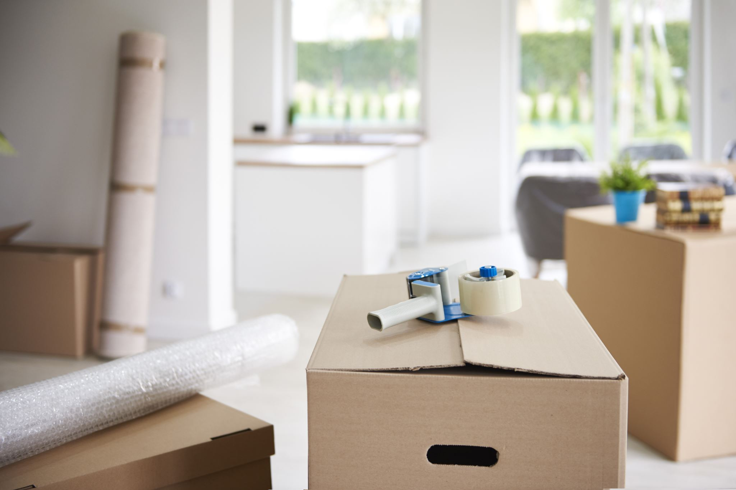
02/15- moving (again)
Halfway through grade 5, we moved into a permanent residence on Parkside Drive, leaving the rental apartment for good. Even though this was a small change, it had big impact in the long term. After grade 5 was over, I had to go to a different middle school than the others, and therefore leave all my friends behind again. I was the only one out of my entire school that went to Eagle Mountain Middle. It took me a while to find my friend group and it also increased my shyness because everyone already knew each other from their elementary school.

Slide 9

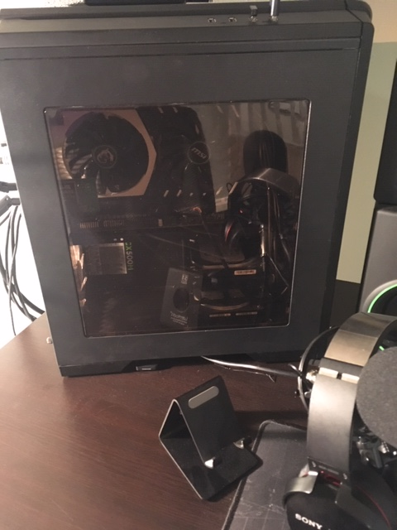
05/15- My first computer
I first got introduced into building your own computer when I first started grade 5. After that, I was determined to save up enough money to buy and build one. A year and 4 months go by and I saved up $800 to build it. I mainly played Minecraft on it since it was the only game I was interested in and because my parents wouldn’t let me play any game that involves killing other people (which I’m annoyed and grateful for). It’s enabled me to expand my list of hobbies as well as helped me with my homework.

Slide 10

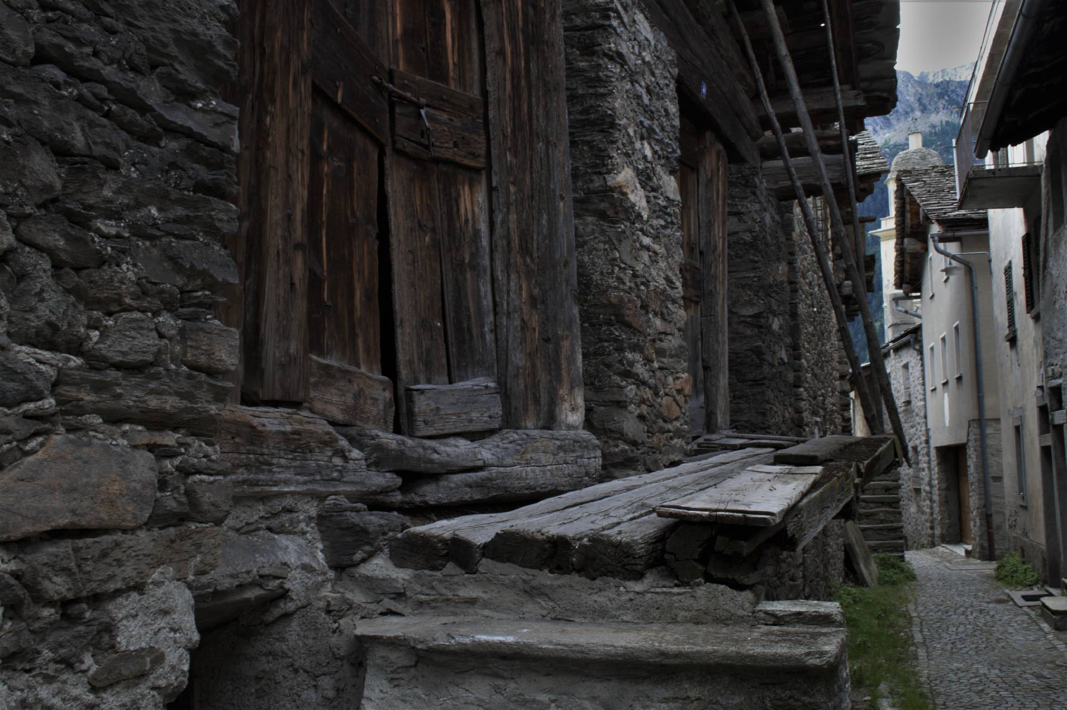
07/16- Europe Trip
During March Break in grade 7, I went to Europe with my parents. We went to visit family in Germany and traveled around France for 2½ weeks. It was a real eye opener into the different cultures around the world since I’d only been to the US. I also had to do a project on the Berlin Wall, which was my main project for the year along with my passion project.

Slide 11
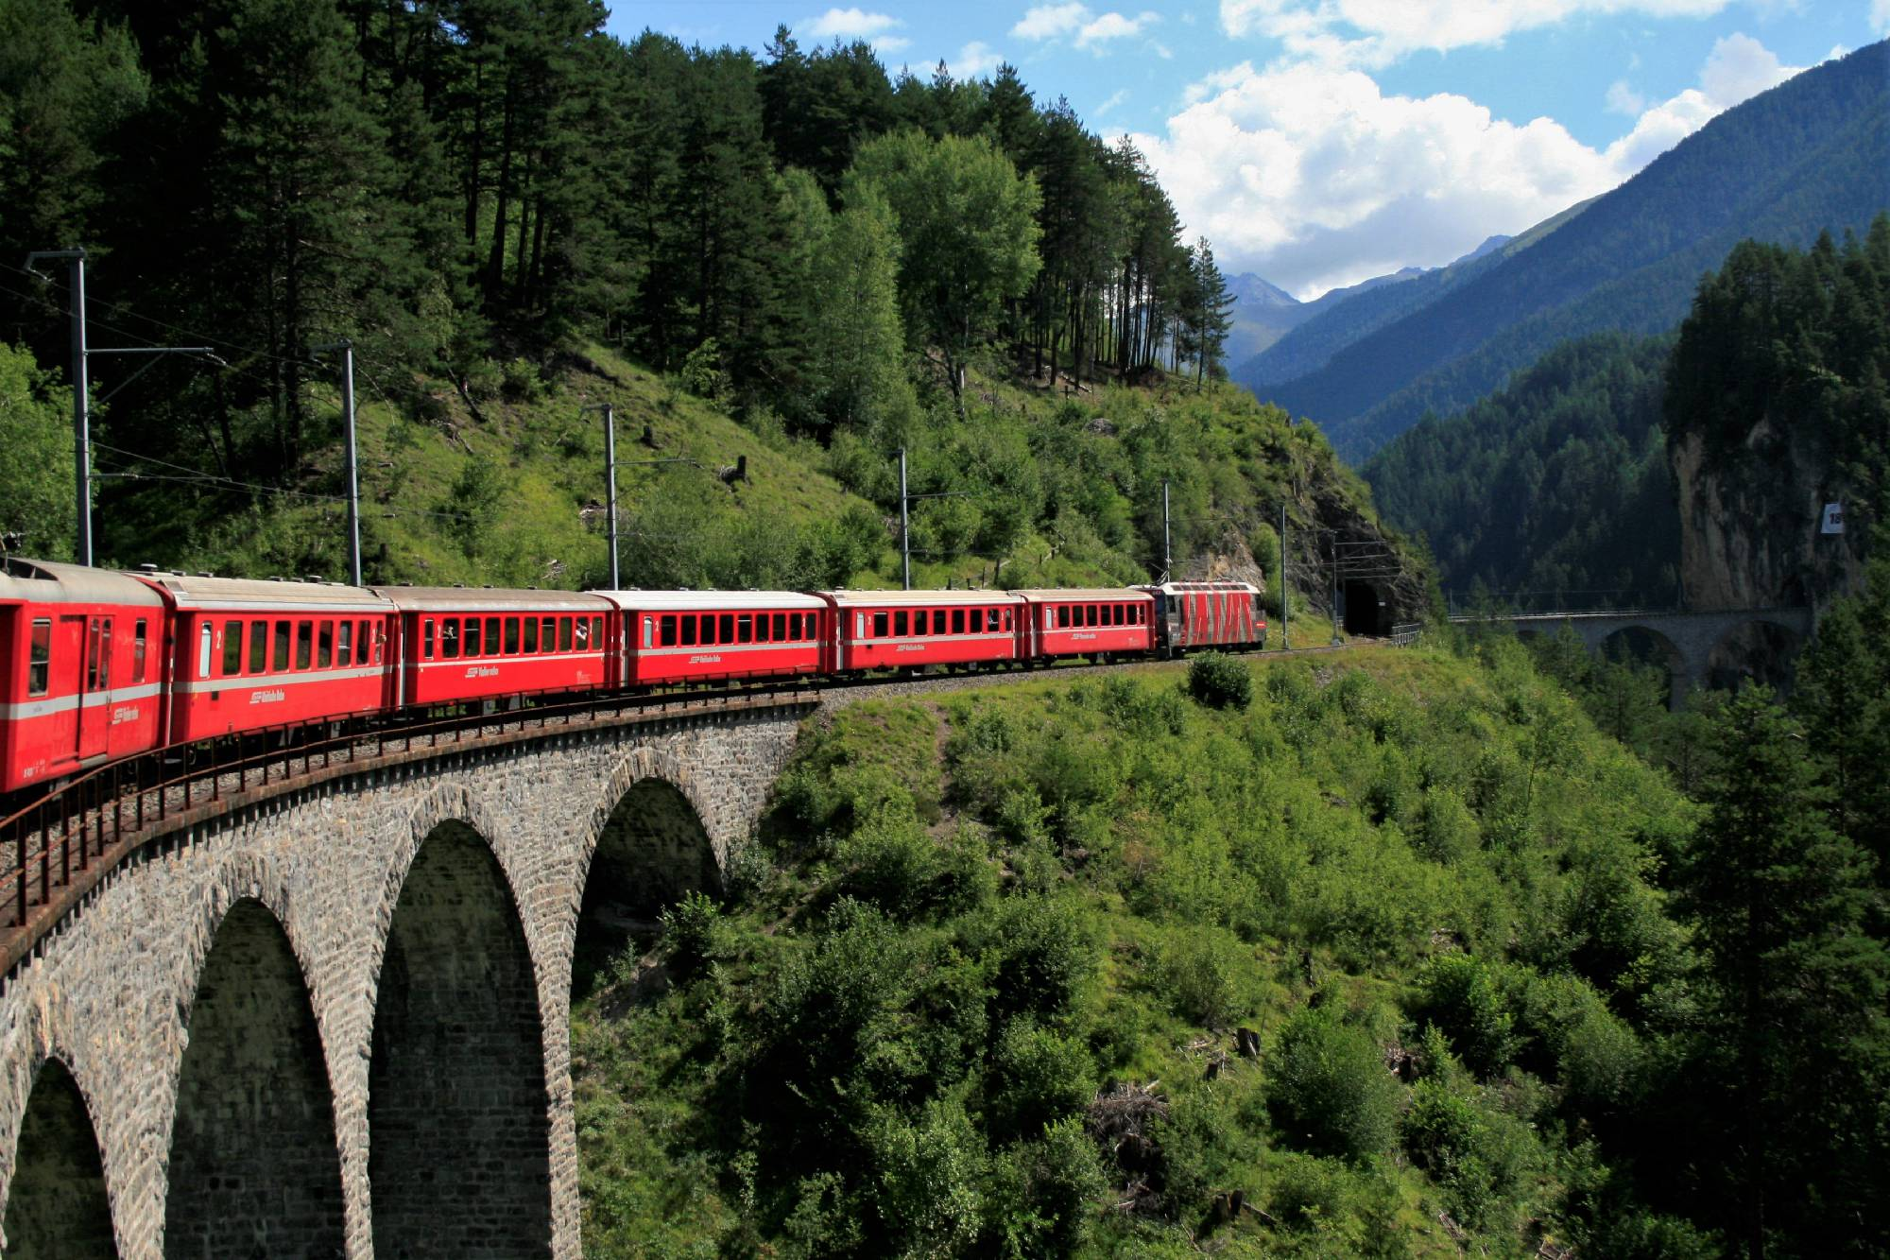
06\17- Europe Trip #2
A year later I went back to Europe with my Oma instead of my parents. We bonded throughout the trip and met a lot more relatives than the previous year. I also learned a lot more German than before. We went to Switzerland beforehand and that’s when my photography hobby took off. I did a passion project on it, and made a website. I saw Europe in a different light that trip.

Slide 12


07/17- inquiry Project
In June of 2017, I got recommended to a school of inquiry since I loved doing the passion projects at school and always delved deeper into my passion than most students. Sadly, I had to decline the invitation to the school due to my past. I’ve changed school so much and I didn’t feel like making new friends again. If that wasn’t the case for me and I was still back in Ottawa, then I most likely would’ve accepted. Now that I think about it again, I feel like I missed out on something unique and special that most people wouldn’t be able to do in their time at school; to inquire.

Slide 13

08/18- BC Bike Trip
During the summer of 2018, my dad and I went on a road trip touring the BC’s interior with our mountain bike for a week. It was an adventure to say the least. It was great bonding time with him and it helped me improve my photography skills, and I would do it again in a heartbeat.

Slide 14

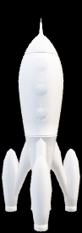
Future Goals

Slide 15


2020- Buy My Own camera
I’ve been into photography for 3 years now and I’m still using my mom’s 11 year old Canon XTi, and I’m now saving up for a brand new camera. I hope to accomplish this before I graduate high school so I can take my camera while travelling Northern BC before I head off to post-secondary.

Slide 16
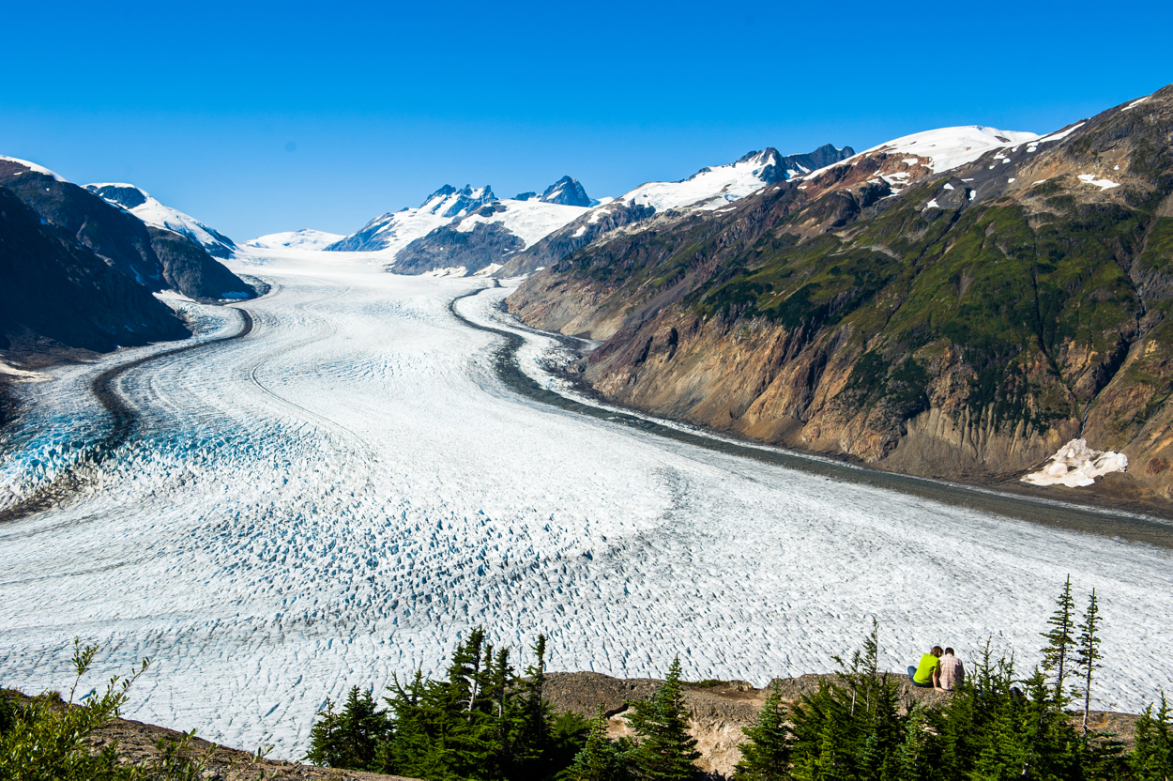
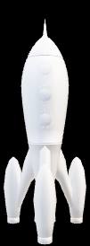
2021- Travel Northern BC
One of my things on my bucket list is to travel around Northern BC, and I think that after graduation is a good time. I hope to see BC like I never had and also take some great pictures of the northern glaciers.

Slide 17


2040- Own my home
Another goal I want to accomplish is to own my home. Ever since we got moved from an apartment into a real home that we owned, there was so much more freedom of what you could do in and to your home, and I don’t want to experience the limited feeling of rental houses for a long time.

Slide 18
Why I chose the signs
The danger sign represents the danger I was in while I had my asthma attack
The no smoking sign represents about the deal I made to my mom about not smoking, drinking, or doing drugs
Every day when walking to school, I saw that sign before I arrived, and symbolises school
I used the stop light icon for the two tragic events because it made me stop and think about other people’s lives
I used the yield sign for the two of the most important decisions of my life because we had to think about the impact of those decisions
I used the construction sign to represent that I hand-built the computer from the components
I used the airplane sign to signify travel
I used the split road sign to represent the choice I had to make with my education
I used the bike sign to represent the bike trip and how much I like biking. I also was a road biker before I got into mountain biking
I used the children playing sign to signify that photography is my hobby, and not my job (not yet at least)
I used the new lane sign to signify that owning your own home will open you up to other possibilities and options

Slide 19

The end

